Slide 1
Rain Event on June 25, 2021
July 15, 2021 Town Hall Meeting

Slide 2
Agenda
Introductions
Opening Remarks by the Mayor
Sewer System Overview
Rainfall Data
What Have We Done?
FEMA
Where Do We Go From Here?
Questions and Answers

Slide 3
GPW Sewer System
Newer communities are designed with separate sewer systems
Convey sanitary and storm water in separate pipe networks
Older communities were designed with combined sewer systems
Convey sanitary and storm water in the same pipe network
Storm water flow rates have higher intensities than sanitary flows
System Overview

Slide 4
Rainfall Data
Historic rainfall levels were recorded in Grosse Pointe Woods and surrounding areas
5.3” of rainfall recorded in 3 hours at Torrey Road Pump Station
Greater than a 1,000 year event

Slide 5
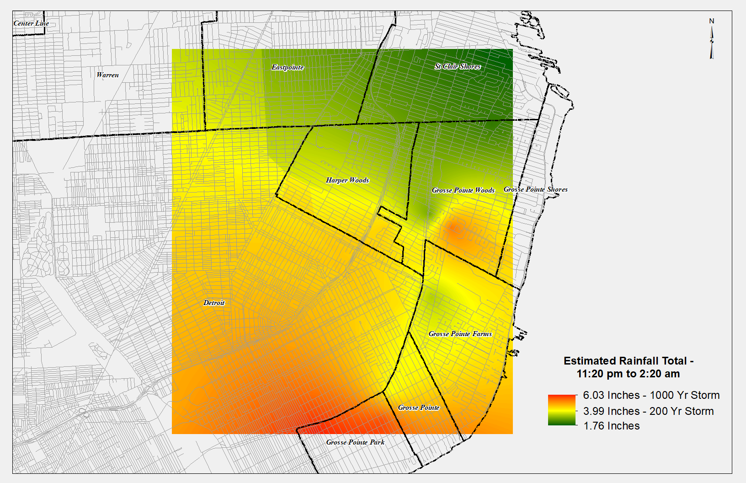

Slide 6
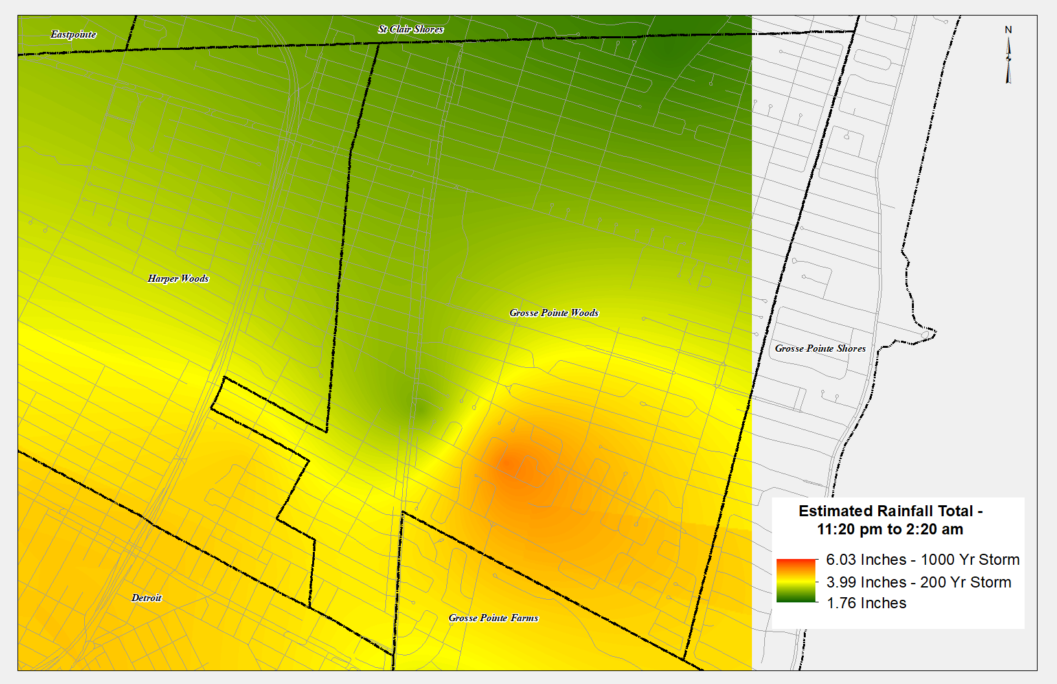

Slide 7
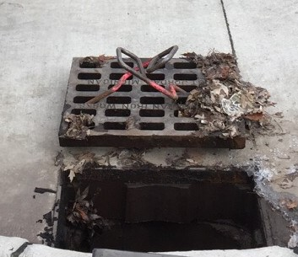
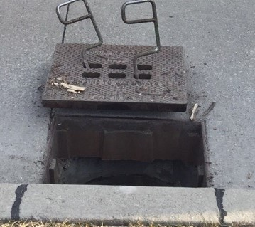
What have we done?
Street Sweeping
Catch Basin Cleaning
Cleaning and Televising Sewers
Lining Defective Sewers
Catch Basin Reconstruction
Sewer Repairs
Downspout Disconnection Ordinance
Restricting Catch Basin Covers

Slide 8
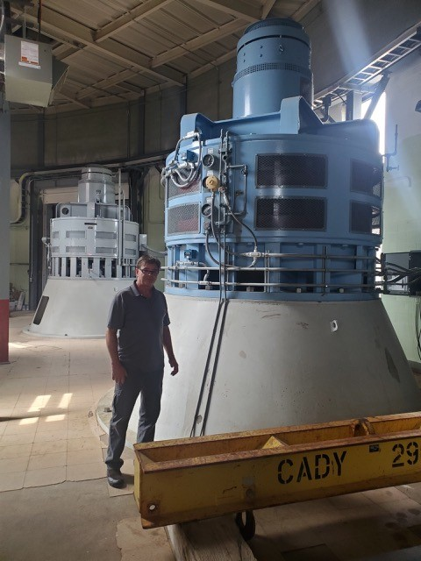
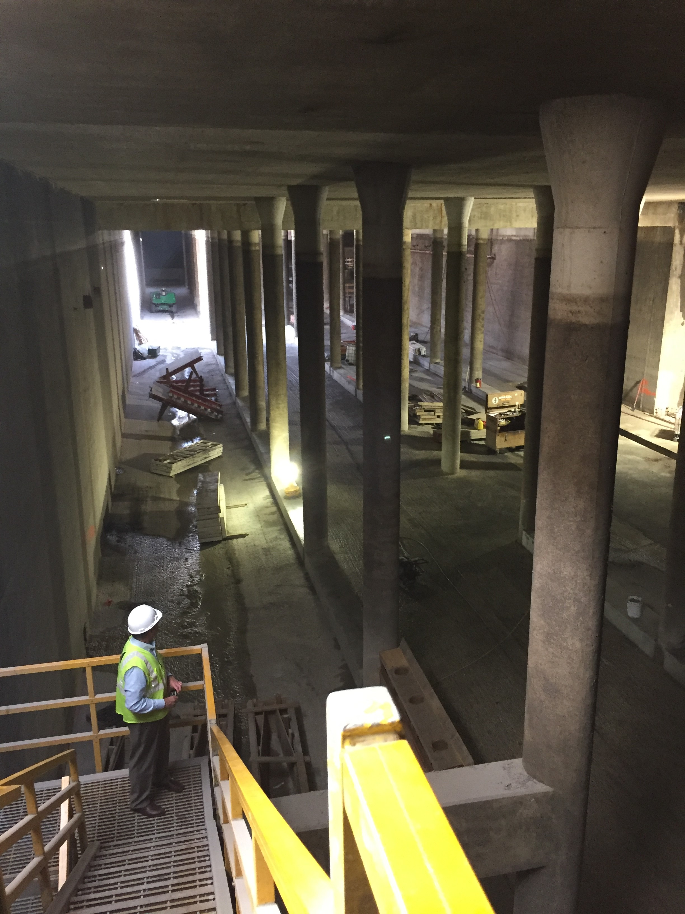
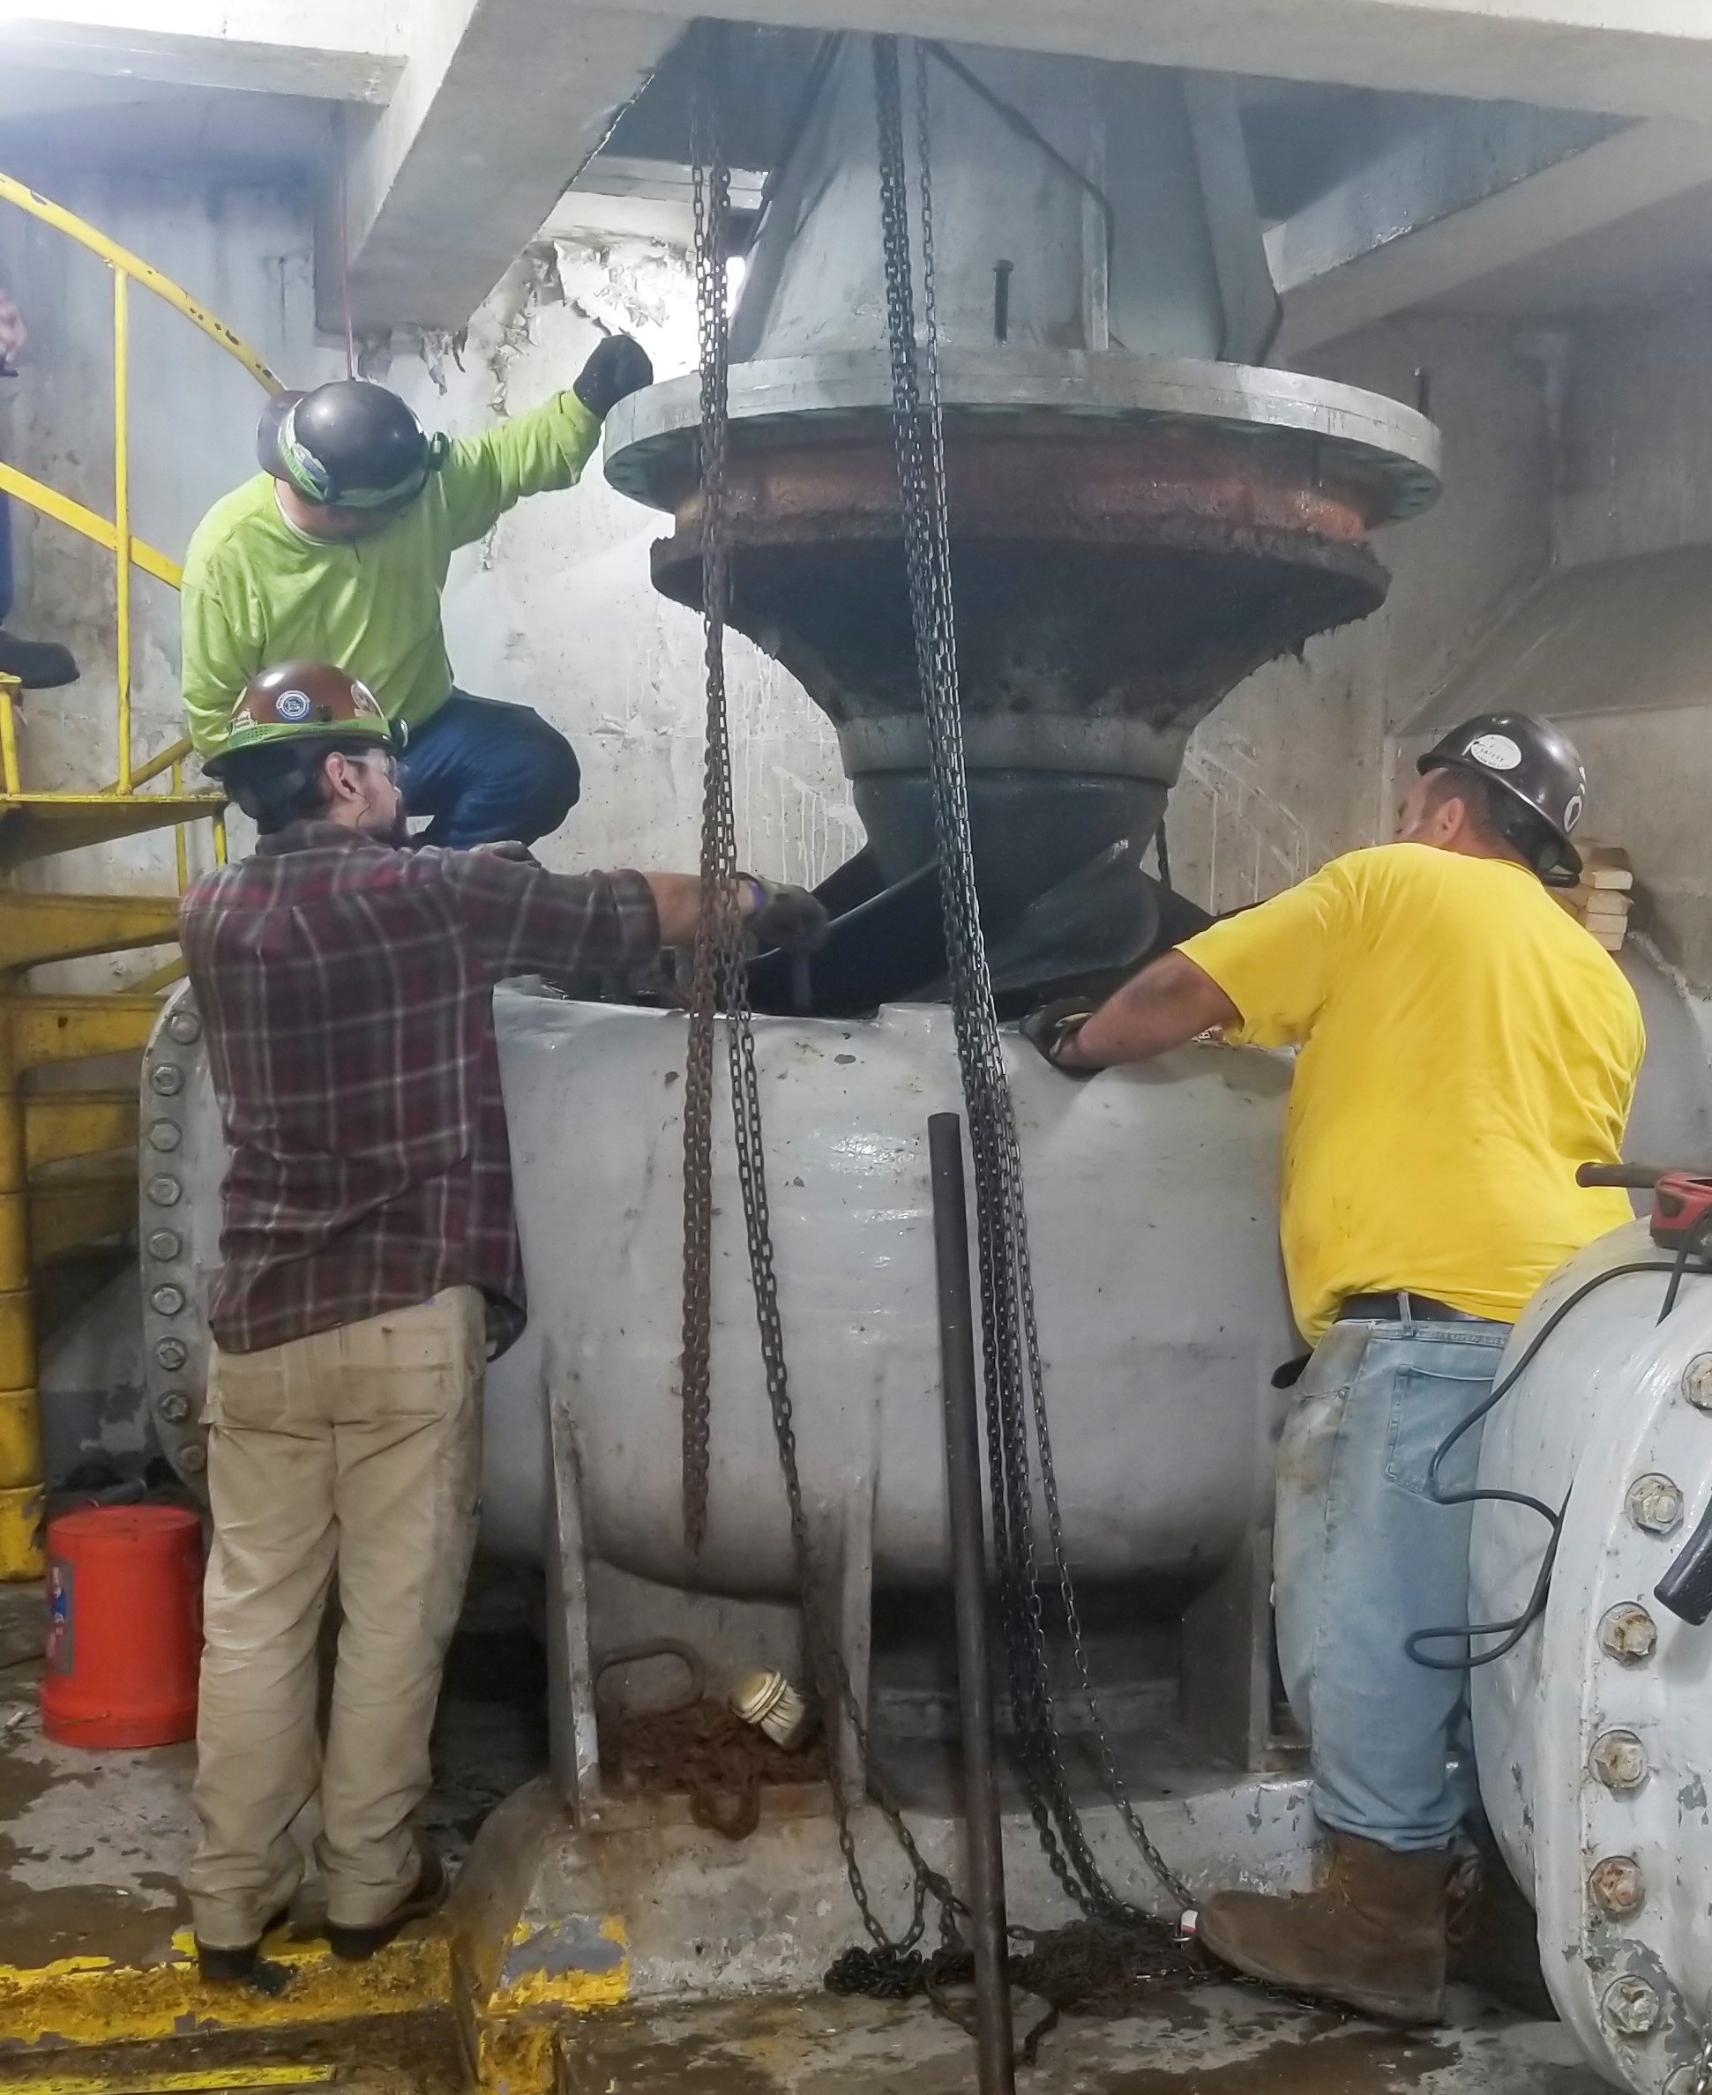
What have we done?
Torrey Road Pump Station
Annual Inspections
Rebuilt Pumps
Milk River Pump Station and Retention Basin Improvements
July 9, 2021 FEMA Visit

Slide 9
Meeting with FEMA
On July 9th, a meeting was held with FEMA with representatives from all of the Grosse Pointe’s and Harper Woods.
FEMA explained the purpose of their visit. Gather data that will be used in the assessment. A Nixle Alert and Eblast was sent out to the community informing the resident’s of FEMA’s visit.
FEMA concentrates on the areas that were impacted the most. FEMA does not go to every home.
Director Kosanke was contacted in the evening and advised FEMA was on their way to Grosse Pointe Woods.
FEMA was directed to the area of IDA Lane based on severity of what was reported and how many homes were effected in the area.

Slide 10
Ida Lane Site Visit
Director Kosanke accompanied FEMA to IDA Lane and observed the process of data collection.
FEMA does not go into homes but will ask questions of the resident.
The following questions were asked:
Did you have any water in your basement, if so how much?
Any problems with your roof leaking?
Do you have any bedrooms in the basement?
Do you have flood insurance?
Have you started to clean up the damage?
How many people live in your home?
How many total bedrooms are in the house
Did water ruin your hot water tank, furnace, washer or dryer?

Slide 11
Additional
FEMA and members of the Michigan State Police Emergency Management Division visited approximately 20 homes on East and West Ida Lane. The teams spent over an hour visiting homes.

Slide 12
Where do we go from here?
City efforts to engage with emergency aid
Review Torrey Road Pump Station data and performance during the June 25 event
Continue televising, cleaning, and rehabilitating sewers
Continue annual inspections of Torrey Road Pump Station
Evaluate catch basin restrictions
Work as a regional body to evaluate system reaction during severe rain events
Claim Forms

Slide 13
Q & A

